Slide 1
Semaphores, Classic problems of Synchronization, Critical regions, Monitors
Prepared By
Dr. Savita Walia
Chitkara University Institute of Engineering and Technology,
Chitkara University, Punjab

Slide 2
Semaphores
Classic Problems of Synchronization
Monitors
Synchronization Examples
Alternative Approaches
Notes:
‹#›

Slide 3
Semaphore
Synchronization tool that provides more sophisticated ways (than Mutex locks) for process to synchronize their activities.
Semaphore S – integer variable
Can only be accessed via two indivisible (atomic) operations
wait() and signal()
Originally called P() and V()
Definition of the wait() operation
wait(S) {
while (S <= 0)
; // busy wait
S--;
}
Definition of the signal() operation
signal(S) {
S++;
}
Notes:
‹#›

Slide 4
Semaphore Usage
Counting semaphore – integer value can range over an unrestricted domain
Binary semaphore – integer value can range only between 0 and 1
Same as a mutex lock
Can solve various synchronization problems
Consider P₁ and P₂ that require S₁ to happen before S₂
Create a semaphore “synch” initialized to 0
P1:
S₁;
signal(synch);
P2:
wait(synch);
S₂;
Can implement a counting semaphore S as a binary semaphore
Notes:
‹#›

Slide 5
Semaphore Implementation
Must guarantee that no two processes can execute the wait() and signal() on the same semaphore at the same time
Thus, the implementation becomes the critical section problem where the wait and signal code are placed in the critical section
Could now have busy waiting in critical section implementation
But implementation code is short
Little busy waiting if critical section rarely occupied
Note that applications may spend lots of time in critical sections and therefore this is not a good solution
Notes:
‹#›

Slide 6
Semaphore Implementation with
no Busy waiting
With each semaphore there is an associated waiting queue
Each entry in a waiting queue has two data items:
value (of type integer)
pointer to next record in the list
Two operations:
block – place the process invoking the operation on the appropriate waiting queue
wakeup – remove one of processes in the waiting queue and place it in the ready queue
typedef struct{
int value;
struct process *list;
} semaphore;
Notes:
‹#›

Slide 7
Implementation with no
Busy waiting (Cont.)
wait(semaphore *S) {
S->value--;
if (S->value < 0) { add this process to S->list;
block();
}
}
signal(semaphore *S) {
S->value++;
if (S->value <= 0) { remove a process P from S->list;
wakeup(P);
}
}
Notes:
‹#›

Slide 8
Deadlock and Starvation
Deadlock – two or more processes are waiting indefinitely for an event that can be caused by only one of the waiting processes
Let S and Q be two semaphores initialized to 1
P₀ P₁
wait(S); wait(Q);
wait(Q); wait(S);
... ...
signal(S); signal(Q);
signal(Q); signal(S);
Starvation – indefinite blocking
A process may never be removed from the semaphore queue in which it is suspended
Priority Inversion – Scheduling problem when lower-priority process holds a lock needed by higher-priority process
Solved via priority-inheritance protocol
Notes:
‹#›

Slide 9
Classical Problems of Synchronization
Classical problems used to test newly-proposed synchronization schemes
Bounded-Buffer Problem
Readers and Writers Problem
Dining-Philosophers Problem
Notes:
‹#›

Slide 10
Bounded-Buffer Problem
n buffers, each can hold one item
Semaphore mutex initialized to the value 1
Semaphore full initialized to the value 0
Semaphore empty initialized to the value n
Notes:
‹#›

Slide 11
Bounded Buffer Problem
The structure of the producer process
do {
... /* produce an item in next_produced */
...
wait(empty);
wait(mutex);
... /* add next produced to the buffer */
...
signal(mutex);
signal(full);
} while (true);
Notes:
‹#›

Slide 12
Bounded Buffer Problem (Cont.)
The structure of the consumer process
Do {
wait(full);
wait(mutex);
... /* remove an item from buffer to next_consumed */
...
signal(mutex);
signal(empty);
... /* consume the item in next consumed */
... } while (true);
Notes:
‹#›

Slide 13
Readers-Writers Problem
A data set is shared among a number of concurrent processes
Readers – only read the data set; they do not perform any updates
Writers – can both read and write
Problem – allow multiple readers to read at the same time
Only one single writer can access the shared data at the same time
Several variations of how readers and writers are considered – all involve some form of priorities
Shared Data
Data set
Semaphore rw_mutex initialized to 1
Semaphore mutex initialized to 1
Integer read_count initialized to 0
Notes:
‹#›

Slide 14
Readers-Writers Problem (Cont.)
The structure of a writer process
do { wait(rw_mutex);
... /* writing is performed */
...
signal(rw_mutex);
} while (true);
Notes:
‹#›

Slide 15
Readers-Writers Problem (Cont.)
The structure of a reader process
do { wait(mutex); read_count++; if (read_count == 1)
wait(rw_mutex);
signal(mutex);
... /* reading is performed */
...
wait(mutex); read count--; if (read_count == 0)
signal(rw_mutex);
signal(mutex);
} while (true);
Notes:
‹#›

Slide 16
Readers-Writers Problem Variations
First variation – no reader kept waiting unless writer has permission to use shared object
Second variation – once writer is ready, it performs the write ASAP
Both may have starvation leading to even more variations
Problem is solved on some systems by kernel providing reader-writer locks

Slide 17
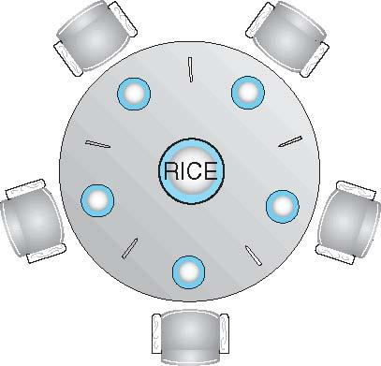
Dining-Philosophers Problem
Philosophers spend their lives alternating thinking and eating
Don’t interact with their neighbors, occasionally try to pick up 2 chopsticks (one at a time) to eat from bowl
Need both to eat, then release both when done
In the case of 5 philosophers
Shared data
Bowl of rice (data set)
Semaphore chopstick [5] initialized to 1
Notes:
‹#›

Slide 18
Dining-Philosophers Problem Algorithm
The structure of Philosopher i:
do {
wait (chopstick[i] );
wait (chopStick[ (i + 1) % 5] );
// eat
signal (chopstick[i] );
signal (chopstick[ (i + 1) % 5] );
// think
} while (TRUE);
What is the problem with this algorithm?
Notes:
‹#›

Slide 19
Dining-Philosophers Problem Algorithm
Deadlock handling
Allow at most 4 philosophers to be sitting simultaneously at the table.
Allow a philosopher to pick up the forks only if both are available (picking must be done in a critical section.
Use an asymmetric solution -- an odd-numbered philosopher picks up first the left chopstick and then the right chopstick. Even-numbered philosopher picks up first the right chopstick and then the left chopstick.
Notes:
‹#›

Slide 20
Problems with Semaphores
Incorrect use of semaphore operations:
signal (mutex) …. wait (mutex)
wait (mutex) … wait (mutex)
Omitting of wait (mutex) or signal (mutex) (or both)
Deadlock and starvation are possible.
Notes:
‹#›

Slide 21
Monitors
A high-level abstraction that provides a convenient and effective mechanism for process synchronization
Abstract data type, internal variables only accessible by code within the procedure
Only one process may be active within the monitor at a time
But not powerful enough to model some synchronization schemes
monitor monitor-name
{
// shared variable declarations
procedure P1 (…) { …. }
procedure Pn (…) {……}
Initialization code (…) { … }
}
}
Notes:
‹#›

Slide 22
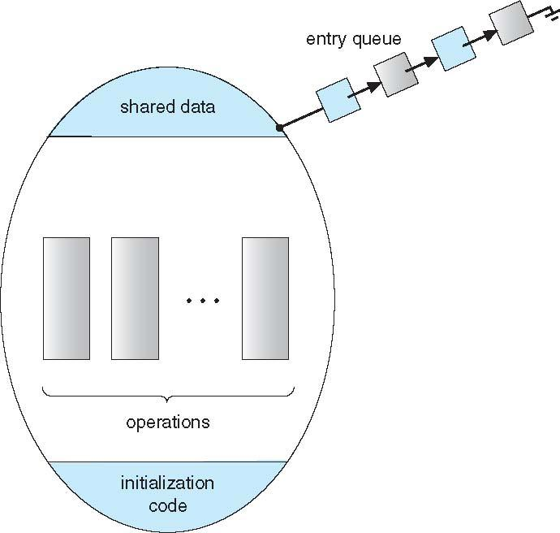
Schematic view of a Monitor
Notes:
‹#›

Slide 23
Condition Variables
condition x, y;
Two operations are allowed on a condition variable:
x.wait() – a process that invokes the operation is suspended until x.signal()
x.signal() – resumes one of processes (if any) that invoked x.wait()
If no x.wait() on the variable, then it has no effect on the variable
Notes:
‹#›

Slide 24
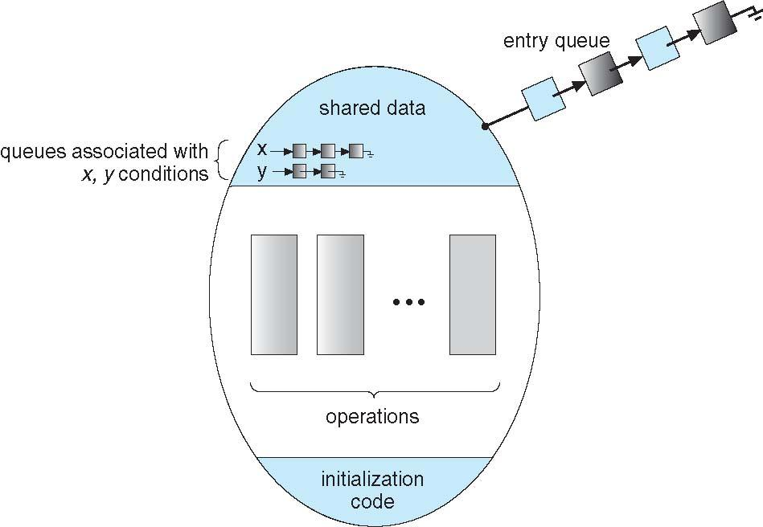
Monitor with Condition Variables
Notes:
‹#›

Slide 25
Condition Variables Choices
If process P invokes x.signal(), and process Q is suspended in x.wait(), what should happen next?
Both Q and P cannot execute in paralel. If Q is resumed, then P must wait
Options include
Signal and wait – P waits until Q either leaves the monitor or it waits for another condition
Signal and continue – Q waits until P either leaves the monitor or it waits for another condition
Both have pros and cons – language implementer can decide
Monitors implemented in Concurrent Pascal compromise
P executing signal immediately leaves the monitor, Q is resumed
Implemented in other languages including Mesa, C#, Java
Notes:
‹#›

Slide 26
Monitor Solution to Dining Philosophers
monitor DiningPhilosophers
{
enum { THINKING; HUNGRY, EATING) state [5] ;
condition self [5];
void pickup (int i) {
state[i] = HUNGRY;
test(i);
if (state[i] != EATING) self[i].wait;
}
void putdown (int i) {
state[i] = THINKING;
// test left and right neighbors
test((i + 4) % 5);
test((i + 1) % 5);
}
Notes:
‹#›

Slide 27
Solution to Dining Philosophers (Cont.)
void test (int i) {
if ((state[(i + 4) % 5] != EATING) &&
(state[i] == HUNGRY) &&
(state[(i + 1) % 5] != EATING) ) {
state[i] = EATING ;
self[i].signal () ;
}
}
initialization_code() {
for (int i = 0; i < 5; i++)
state[i] = THINKING;
}
}
Notes:
‹#›

Slide 28
Solution to Dining Philosophers (Cont.)
Each philosopher i invokes the operations pickup() and putdown() in the following sequence:
DiningPhilosophers.pickup(i);
EAT
DiningPhilosophers.putdown(i);
No deadlock, but starvation is possible
Notes:
‹#›

Slide 29
Monitor Implementation Using Semaphores
Variables
semaphore mutex; // (initially = 1)
semaphore next; // (initially = 0)
int next_count = 0;
Each procedure F will be replaced by
wait(mutex);
…
body of F;
…
if (next_count > 0)
signal(next)
else
signal(mutex);
Mutual exclusion within a monitor is ensured
Notes:
‹#›

Slide 30
Monitor Implementation – Condition Variables
For each condition variable x, we have:
semaphore x_sem; // (initially = 0)
int x_count = 0;
The operation x.wait can be implemented as:
x_count++;
if (next_count > 0)
signal(next);
else
signal(mutex);
wait(x_sem);
x_count--;
Notes:
‹#›

Slide 31
Monitor Implementation (Cont.)
The operation x.signal can be implemented as:
if (x_count > 0) {
next_count++;
signal(x_sem);
wait(next);
next_count--;
}
Notes:
‹#›

Slide 32
Resuming Processes within a Monitor
If several processes queued on condition x, and x.signal() executed, which should be resumed?
FCFS frequently not adequate
conditional-wait construct of the form x.wait(c)
Where c is priority number
Process with lowest number (highest priority) is scheduled next

Slide 33
Single Resource allocation
Allocate a single resource among competing processes using priority numbers that specify the maximum time a process plans to use the resource
R.acquire(t);
...
access the resurce;
...
R.release;
Where R is an instance of type ResourceAllocator
Notes:
‹#›

Slide 34
A Monitor to Allocate Single Resource
monitor ResourceAllocator
{
boolean busy;
condition x;
void acquire(int time) {
if (busy)
x.wait(time);
busy = TRUE;
}
void release() {
busy = FALSE;
x.signal();
}
initialization code() {
busy = FALSE;
}
}
Notes:
‹#›

Slide 35
Synchronization Examples
Solaris
Windows
Linux
Pthreads
Notes:
‹#›

Slide 36
Solaris Synchronization
Implements a variety of locks to support multitasking, multithreading (including real-time threads), and multiprocessing
Uses adaptive mutexes for efficiency when protecting data from short code segments
Starts as a standard semaphore spin-lock
If lock held, and by a thread running on another CPU, spins
If lock held by non-run-state thread, block and sleep waiting for signal of lock being released
Uses condition variables
Uses readers-writers locks when longer sections of code need access to data
Uses turnstiles to order the list of threads waiting to acquire either an adaptive mutex or reader-writer lock
Turnstiles are per-lock-holding-thread, not per-object
Priority-inheritance per-turnstile gives the running thread the highest of the priorities of the threads in its turnstile
Notes:
‹#›

Slide 37
Windows Synchronization
Uses interrupt masks to protect access to global resources on uniprocessor systems
Uses spinlocks on multiprocessor systems
Spinlocking-thread will never be preempted
Also provides dispatcher objects user-land which may act mutexes, semaphores, events, and timers
Events
An event acts much like a condition variable
Timers notify one or more thread when time expired
Dispatcher objects either signaled-state (object available) or non-signaled state (thread will block)
Notes:
‹#›

Slide 38
Linux Synchronization
Linux:
Prior to kernel Version 2.6, disables interrupts to implement short critical sections
Version 2.6 and later, fully preemptive
Linux provides:
Semaphores
atomic integers
spinlocks
reader-writer versions of both
On single-cpu system, spinlocks replaced by enabling and disabling kernel preemption
Notes:
‹#›

Slide 39
Pthreads Synchronization
Pthreads API is OS-independent
It provides:
mutex locks
condition variable
Non-portable extensions include:
read-write locks
spinlocks
Notes:
‹#›

